Slide 1

Introduction to Android App Development
Stefan Martynkiw, E.I.T

Slide 2
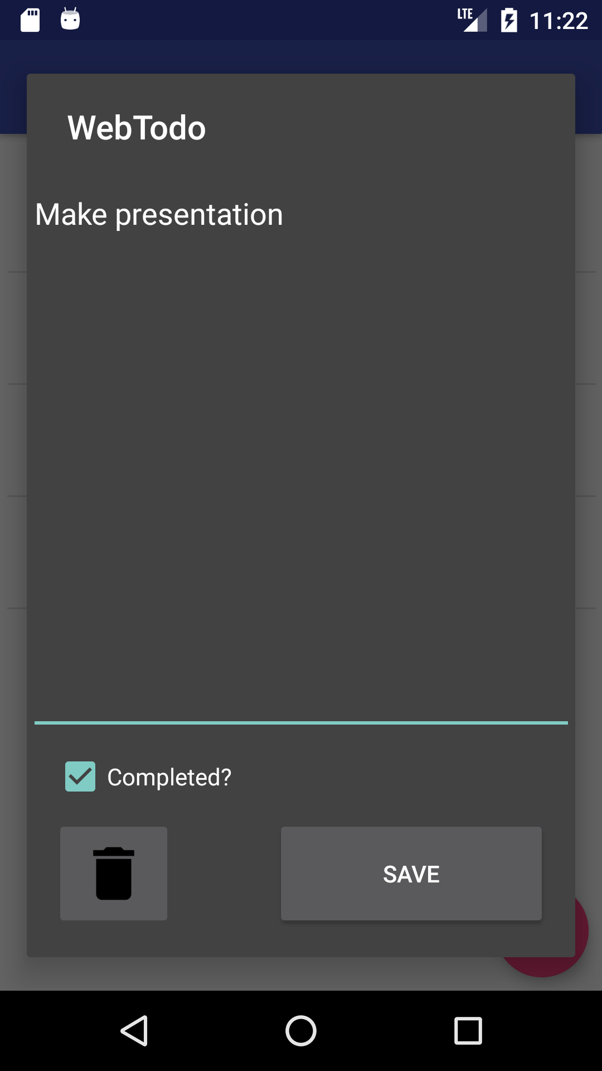
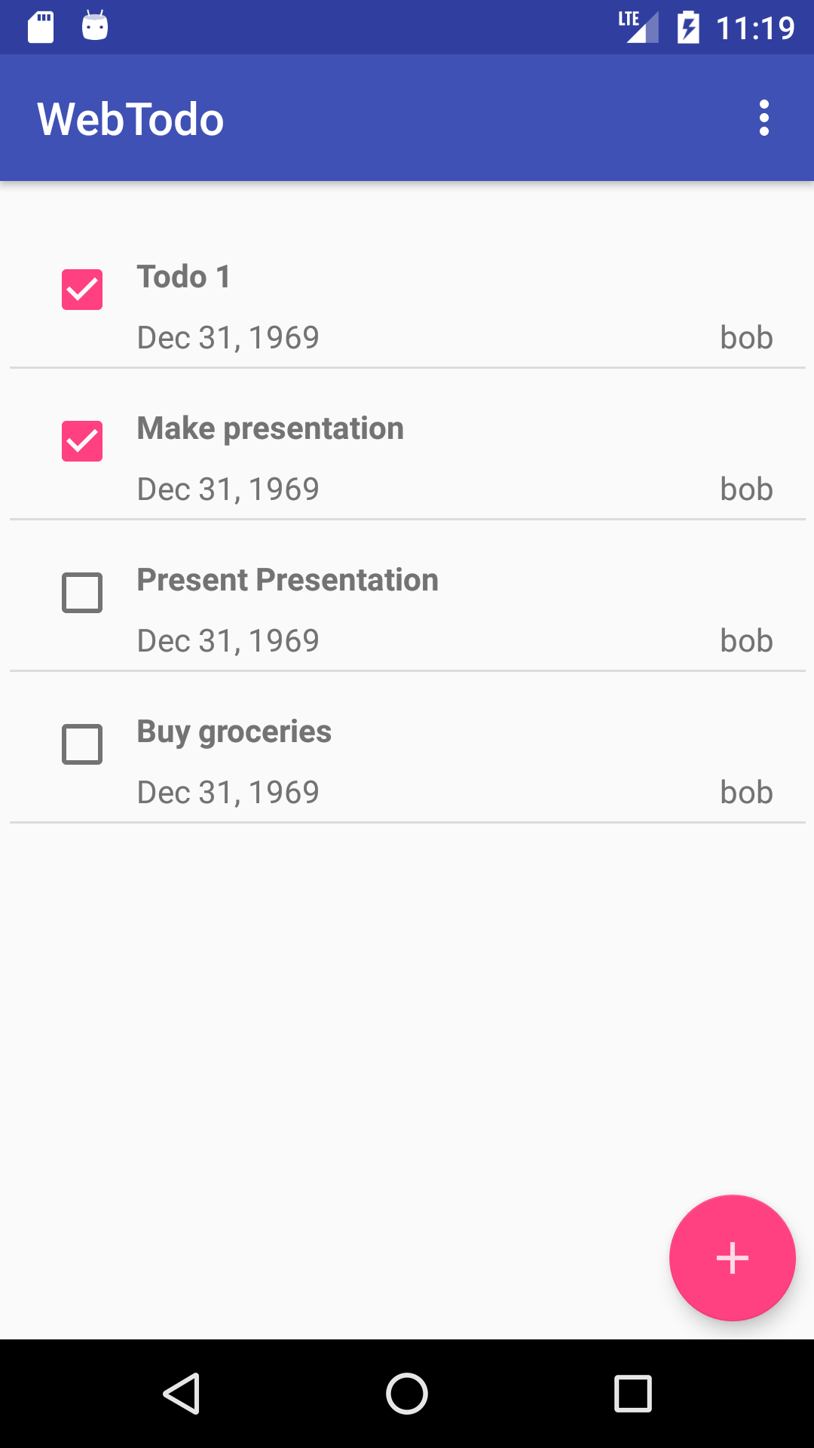
Workshop Overview
A guided tour through the theory and practice of building a web-enabled Todo list from first principles.
A tour around Android Studio & Development Tools
Android patterns:
Application Structure
Activities and Services
Communicating with RESTful web services
Notes:
This is what we’re going to be making!

Slide 3

About Me
Android developer at Drivewyze
University of Alberta Computer Engineering graduate
Hobby projects:
Tinkering with electronics
Learning new things
Notes:
Recently graduated from computer engineering,
Currently an Android Developer At Drivewyze here in Edmonton. Drivewyze is an app that provides road safety notifications and highway-side weigh-station bypass in partnership with law enforcement in 39 US states.
In my spare time, I like to:
-- tinker with computers and electronics
-- Lean new programming languages and techniques
--
I’m rcstatic to be presenting here at Student Devcon.

Slide 4
Preview
Android: The View From Afar
History
Debugging
Testing
Development Tools:
Android Studio
Emulator
Running your app
Debugging
Building Blocks
Activities
Services
AsyncTasks & Threading
Code Demo

Slide 5
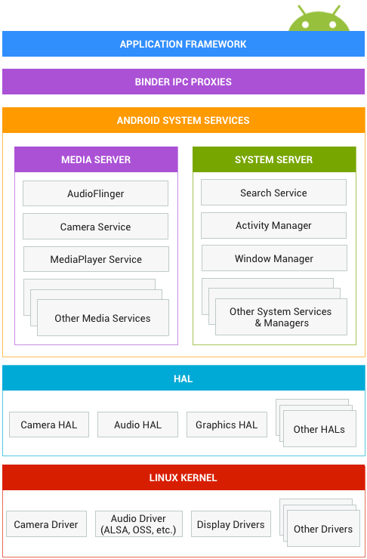
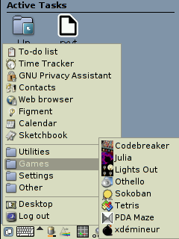
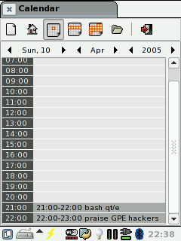
Android Tech Stack: View from Afar
Linux-based, but with many special parts.
Designed to isolate the developer and user from low-level operating system constructs and provide a unified user experience.
Screenshots, GNU Palmtop Environment https://en.wikipedia.org/wiki/GPE
Notes:
20,000ft overview.
Android can be thought of as a very special Linux-based operating system.
It has a Linux kernel way deep under the hood that does all of the usual operating system things:
- Hardware drivers,
- Threading, Inter-Process Communication
- Power Management
Further up the ladder, there are the Android System Services. These provide niceties such as:
-Graphical display, window management,
- Input handling
- Media/Sound Routing
- Unified search
Tightly-integrated system services allowed Mobile computing to evolve from thinks like GPE (shown above) and Windows CE into modern mobile environments like Android and iOS.
Most Android Developers only work with the APIs (Application Programming Interfaces) exposed in the “Application Framework” layer, however.
But, if you decide to build your own Android device, or get into making custom Android ROMs, then the rest of these layers are quite important.
Picture source:
https://source.android.com/devices/

Slide 6


Android Tech Stack: Debugging
Debugging software on a phone has challenges:
Installing app onto phone
Logging output needs to go somewhere
Push/Pull files from phone
Code Breakpoints
Android has a solution: ADB, the Android Debug Bridge.
ADB Daemon
ADB Server
ADB Client
(Android Studio)
ADB Client
(Command Line)
Notes:
At first glance, debugging an application on a phone seems daunting:
- How do I install my application on the phone?
- Once it’s installed, how can I do the equivalent of a print statement? Where do these print lines go?
- If my application creates files, how can I download them to my development machine for inspection?
- How do I simulate various scenarios on the phone: No/slow wifi/cellular, different location, network port-forwarding, etc.
- How do I set breakpoints in my code, and how does the phone communicate debug commands to the development machine
All of these questions and more are solved by the “Android Debug Bridge”
There is a command-line adb which is handy, although the most user-friendly use of ADB is in Android Studio, which we’ll get into shortly.
--Talk about how the constraints
ADB, Emulation, dev tools.
List all the things adb can do.
Segue into the dev tools section.’

Slide 7
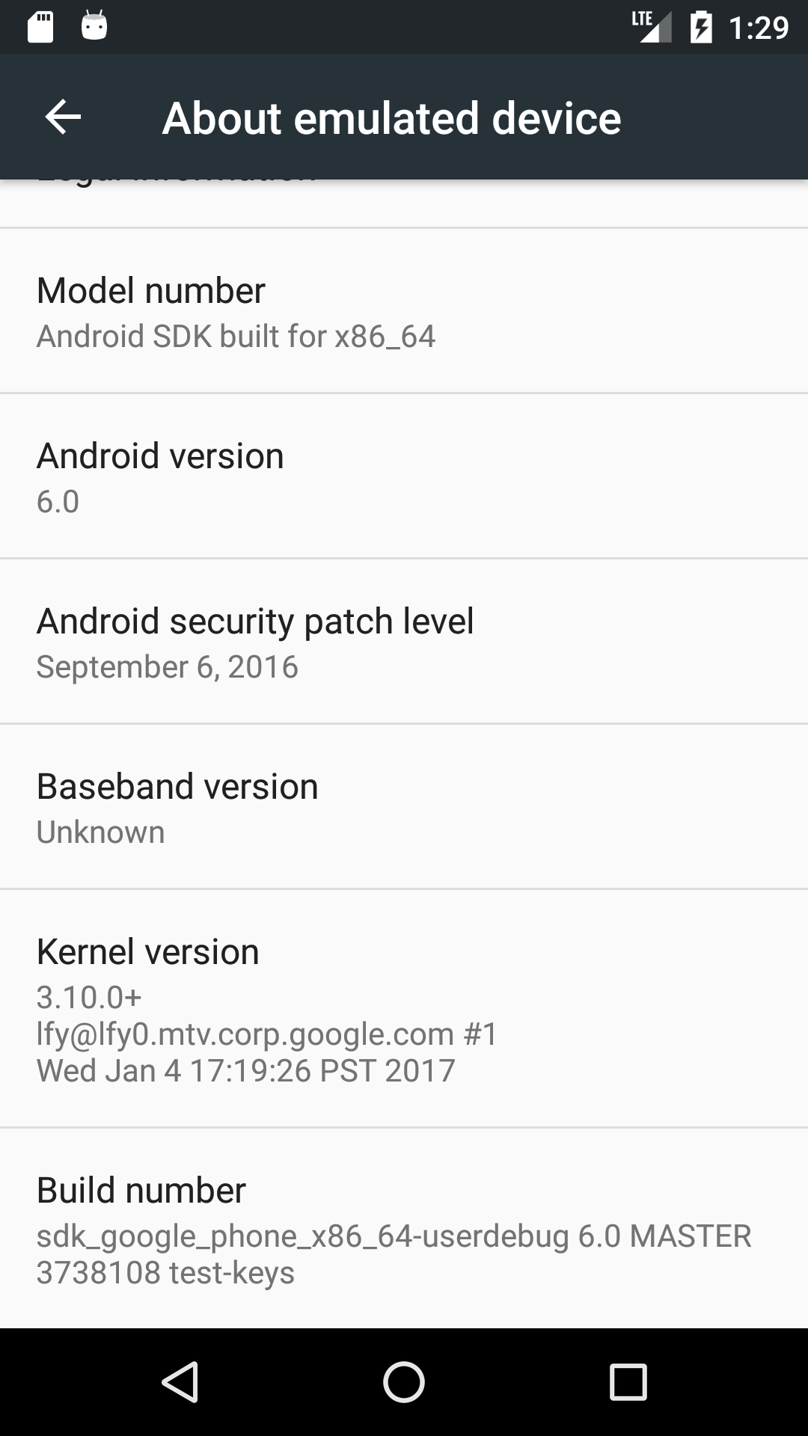
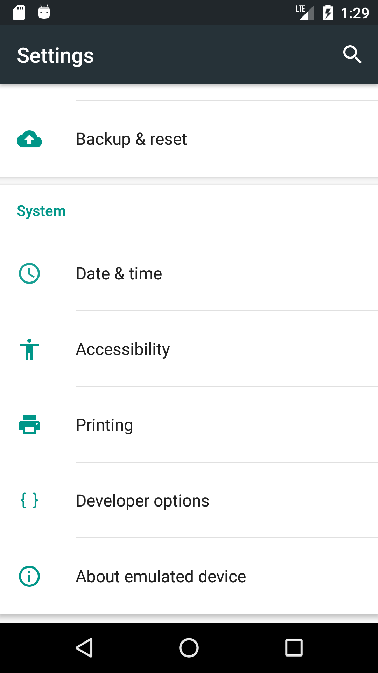
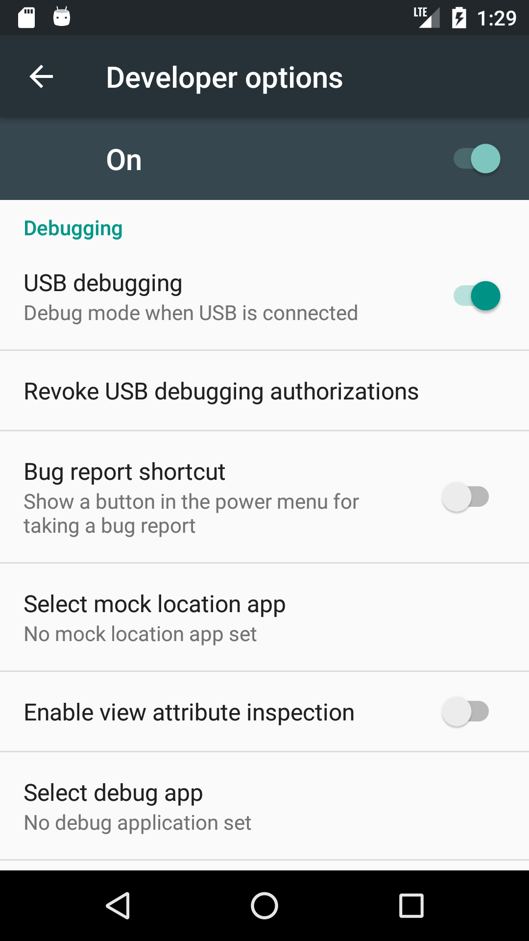
Debugging: Developer Mode
These days, the Android Emulator simulates phones well-enough for most development.
However, there are times when you want to debug your app on a real device:
Interfacing with Bluetooth
Device-specific quirks
Inter-op with other apps that interface with hardware
To enable debugging on your phone, you need to enable “Developer Mode”
Go to Settings -> About Device.
Tap on the Build Number list item 10 times.
Notes:
-- Don’t complain about how slow Eclipse ADT was in CMPUT 301.

Slide 8
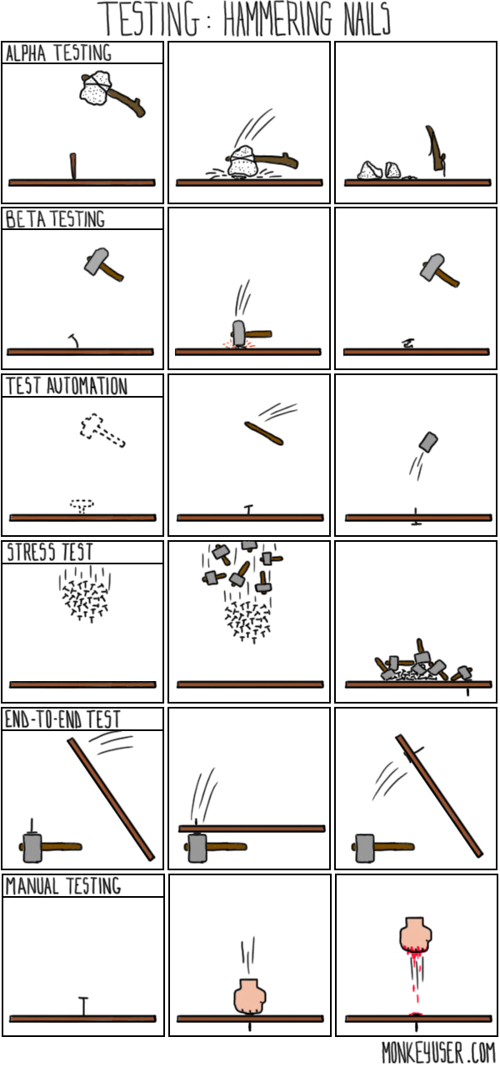
Android Tech Stack: Testing
Android apps can be tested with many testing techniques:
Unit Testing (Junit / Robolectric)
User Interface Testing (Espresso)
Integration Testing
Instrumented Tests
Tests run against your code on a device (real or emulated)
Local Tests
Tests run against your code on the development machine’s JVM
Comic source: http://www.monkeyuser.com/2016/testing-hammering-nails/
Notes:
Briefly talk about testing. Instrumented tests & Robolectric tests.
Although testing is out of the scope for this talk, I’d like to mention the various testing techniques that can be use to test your app.
- Unit testing is the idea that you break your code down into small testable “units” of code. Unit tests stimulate your code to
assert that it behaves correctly when good and bad data is given as an input (boundary value analysis). Writing comprehensive
unit tests lets you make sure that your code behaves the same way it’s supposed to if you intentionally or unintentionally change
its implementation.
- User Interface testing focuses on making sure the User Interface works as expected. The central idea here is to simulate a user interacting
with the app: clicking buttons, scrolling, opening/closing the app. Where unit testing tries to make sure that each bit of code (often not visible to the user) works
properly, UI testing tries to make sure that each bit of visible user interface works properly. For small apps, UI testing can be done manually, though just like
unit testing, it is very advantageous to automate UI testing. Android studio comes with tools to make writing automated UI tests easier.
- Integration testing is related to the systems that your application talks to. Few apps are an island unto themselves: they often talk to servers, authenticate, shuffle
data around. Integration testing tests to make sure that the app behaves properly within a larger system of software components and projects.
When implementing your test cases, you have the choice of implementing them as Instrumented tests or as local tests.
Instrumented tests have the chief disadvantage of being slower that local tests. For each test case, the instrumented test runner needs to push your app code and test code to a device (real or emulated) over adb, start the test framework, run the test, then fetch the results over adb. It can be quite slow when your test case count is large.
Instrumented tests, however, have an advantage: Because the test is running on a device, your tests can make calls to the Android API to retrieve device specific information, such as phone numbers, battery state, and cellular network strength.
There are also test-lab services out there: for a fee, you can pay for time in a cloud test lab, push your test suite over the internet to a room full of a variety of phones, and have the results returned to you.
Attempting to make these same device-specific calls in a local test will result in an exception indicating the API call needs to be mocked out.
Robolectric is a library that tries to bridge the gap between local tests and Instrumented tests: Robolectric mocks out most android services with default, predictable behavior. It also allows you to stimulate your code lifecycles much like instrumented tests.
Although implementing testing techniques is out of scope for this presentation, it is certainly important to keep in mind as you develop software. When designing software, it’s important to ask how the code will be tested.

Slide 9
Development Tools

Slide 10
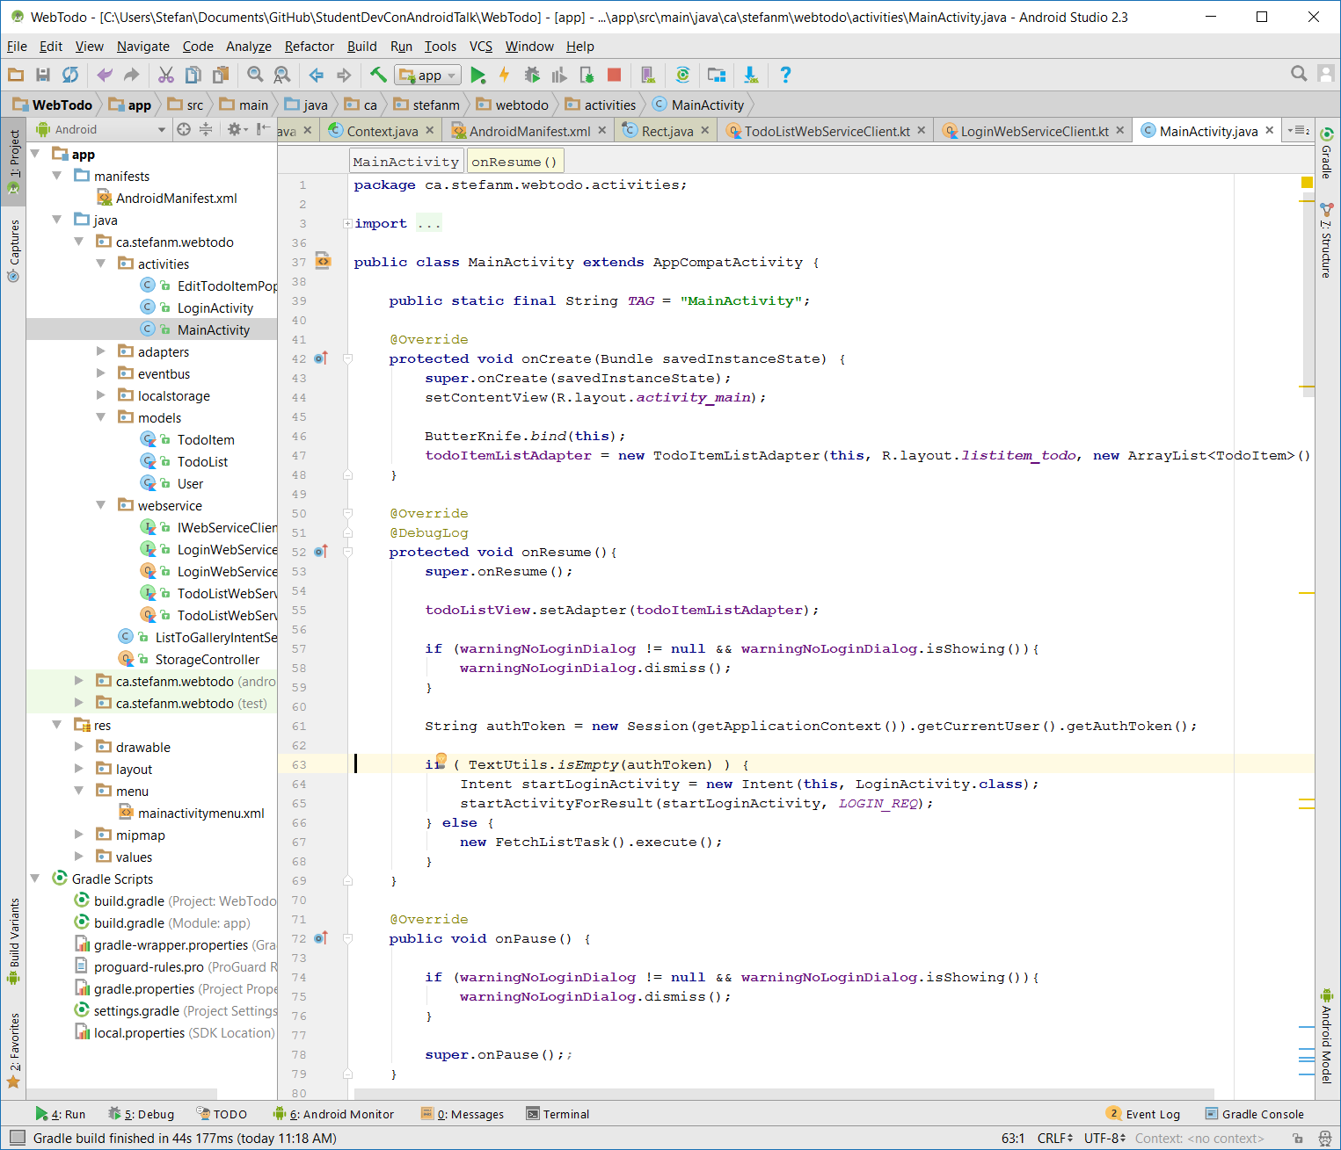


Android Development Tools
Android Studio is the official Integrated Development Environment (IDE) provided by Google.
Xamarin is an alternative to Android Studio made by Microsoft, using C# & Visual Studio.
Notes:
Most Android development is done using Android Studio.
Android Studio is the official development environment provided by Google to develop Android Applications. It’s based on the IntelliJ IDE
There are other development environments that can be used to develop android apps, most notably, Xamarin. Xamarin is a set of APIs and tools developed by Microsoft that allow developers to make android apps using C# and Visual Studio.
Many apps, as well as worked example for this workshop, are developed in Android Studio, so we’ll focus on that, since it’s the most commonly used tool to develop Android apps.

Slide 11
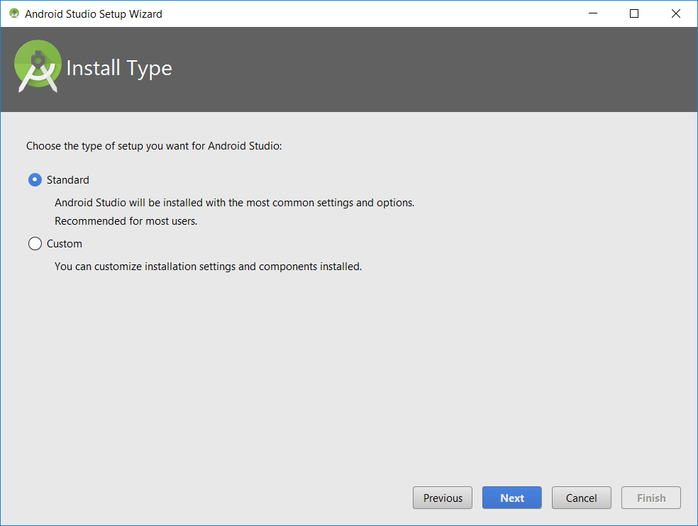
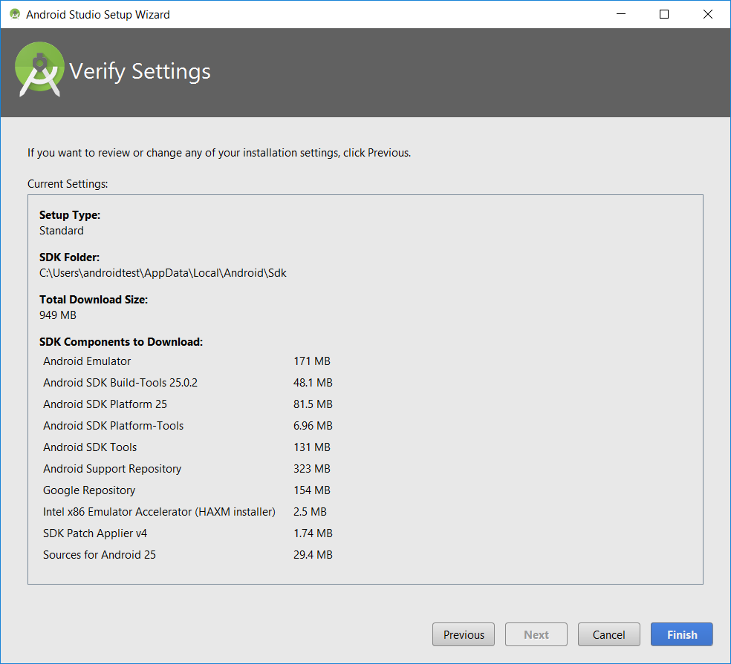
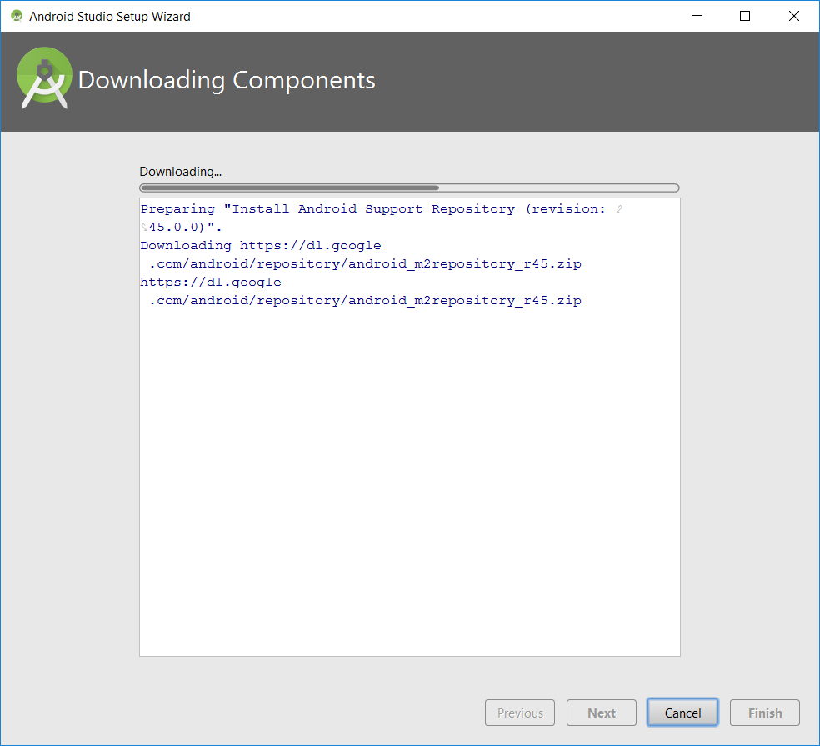
Android Studio Setup: Overview
Developing on Android requires many components to be installed:
Emulator
SDK Build Tools
SDK Platform
SDK Tools
Android Support Repository
Intel HAXM Emulator Accelerator
Android API Sources
Download sizes are large
Notes:
There are many components that need to be installed to develop an app that runs on Android.
Fortunately, when starting Android studio for the first time, the “Standard” installation type contains defaults that’ll get you going quickly. (After a 950 megabyte download though).

Slide 12

Android Studio Components: Versions
Choosing the minimum version of Android your app supports is important. It depends on
Your clientele
Just you, tech people, students, your grandparents’ phones, etc…
Features desired
Android Wear, Auto, etc.
Recommended minimum version:
For general release: 19 or 21
For a school project: 21 or 23
Code Name | Version Number | Release Year | API Level | Market Share
Nougat | 7.0 - 7.1.1 | 2016 | 24-25 | 2.6%
Marshmallow | 6.0 - 6.0.1 | 2015 | 23 | 31.3%
Lollipop | 5.0 - 5.1.1 | 2014 | 21-22 | 32.5%
KitKat | 4.4 - 4.4.4 | 2013 | 19 | 20.8%
Jelly Bean | 4.1 – 4.3.1 | 2012 | 16-18 | 10.6%
Ice Cream Sandwich | 3.0 – 3.2.6 | 2011 | 14-15 | 1%
Sources: https://developer.android.com/about/dashboards/index.html#Platform,
https://en.wikipedia.org/wiki/Android_version_history
Notes:
Api versions and support.
Talk about min, target, compile. As well as the support library.
Material design introduced in Lollipop, though it can be simulated on Android 4 using the support library.
Android Wear introduced in API 20.

Slide 13
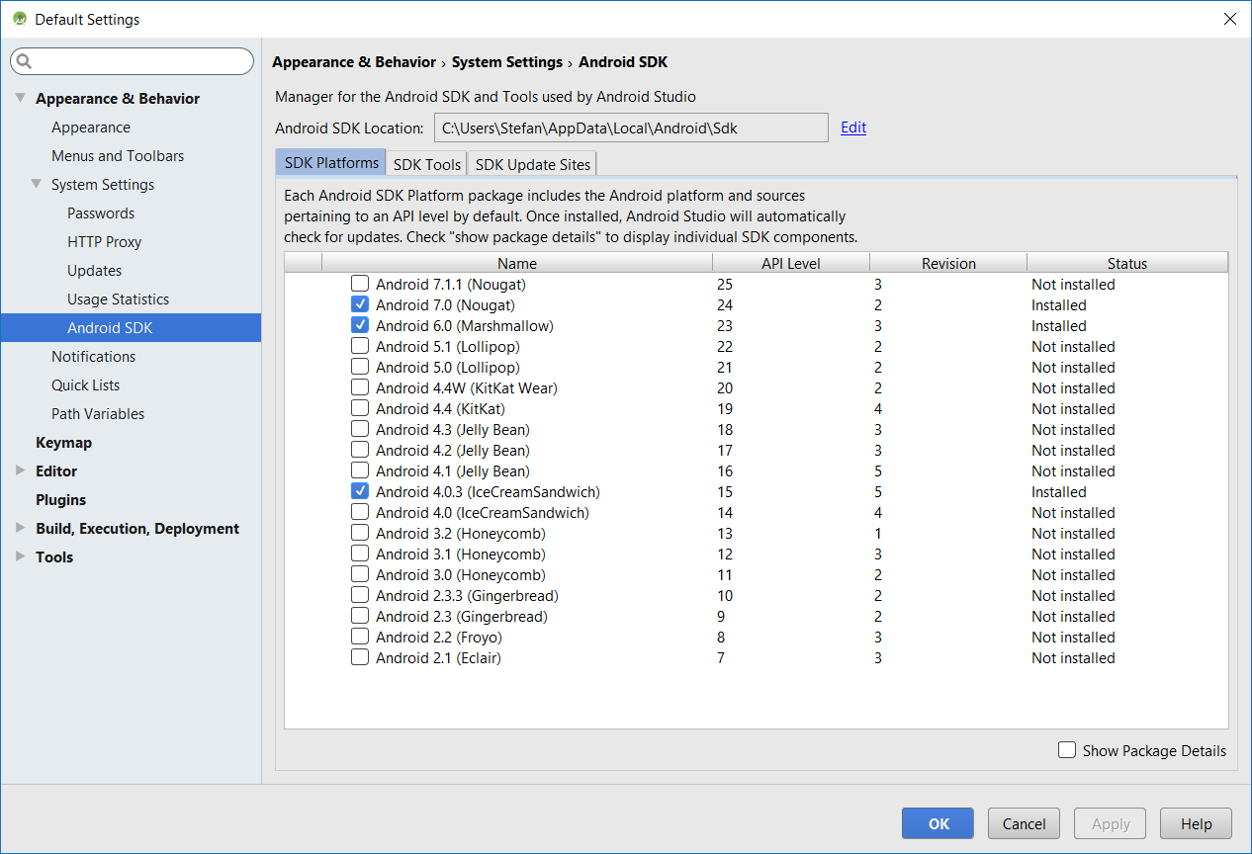
Android Studio Components: SDK Manager
Tools → Android → SDK Manager
It’s handy to have several versions of the Android SDK installed

Slide 14
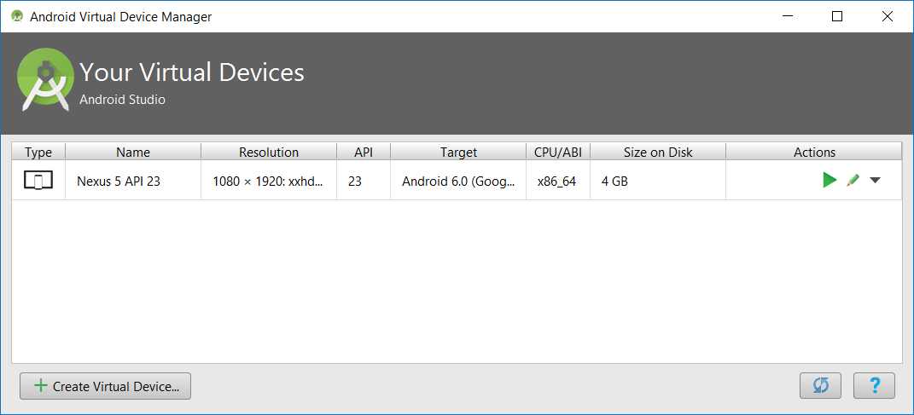
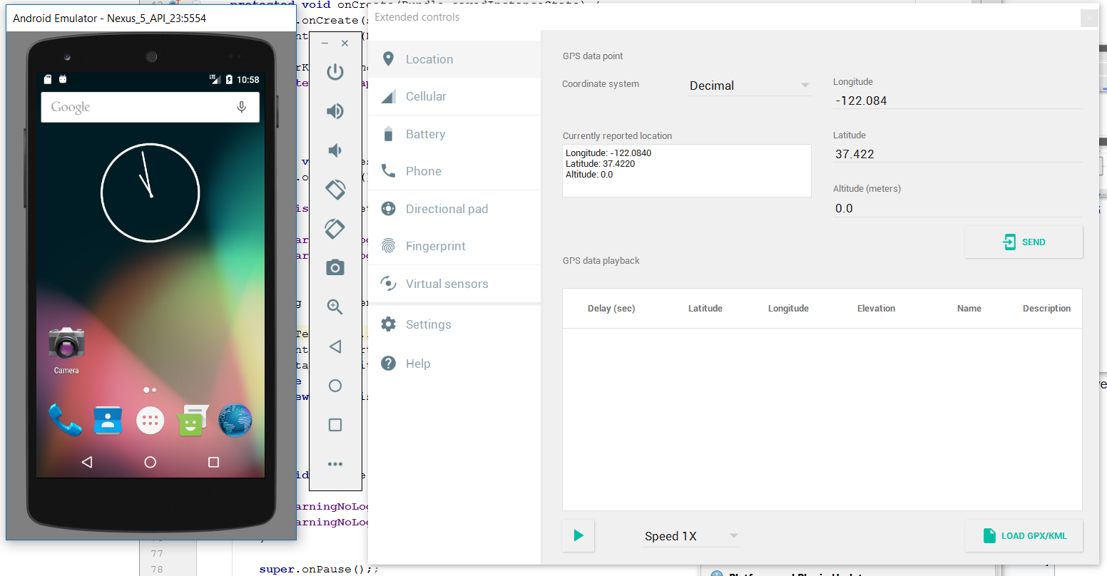
Android Studio Setup: Emulator
Android Virtual Devices (AVDs) are handy for testing
You can make multiple AVDs. Best practice to make an AVD for:
Minimum supported API version
Target API version (+-1)
Latest API version
Tools -> AVD Manager
Each AVD needs a system image. (More large downloads)
Notes:
You can make many instances of the Android Emulator to simulate multiple phones. Each instance can run a different version of Android.
It’s generally good practice to make an Android Virtual Device for your:
- Minimum supported API version
- Target API Version (plus or minus one version)
- The latest API Version
AVDs are managed using Tools -> AVD Manager. In here, you can make new AVDs, and download the copies of the Android System image that will run the phone., (More large downloads!)

Slide 15
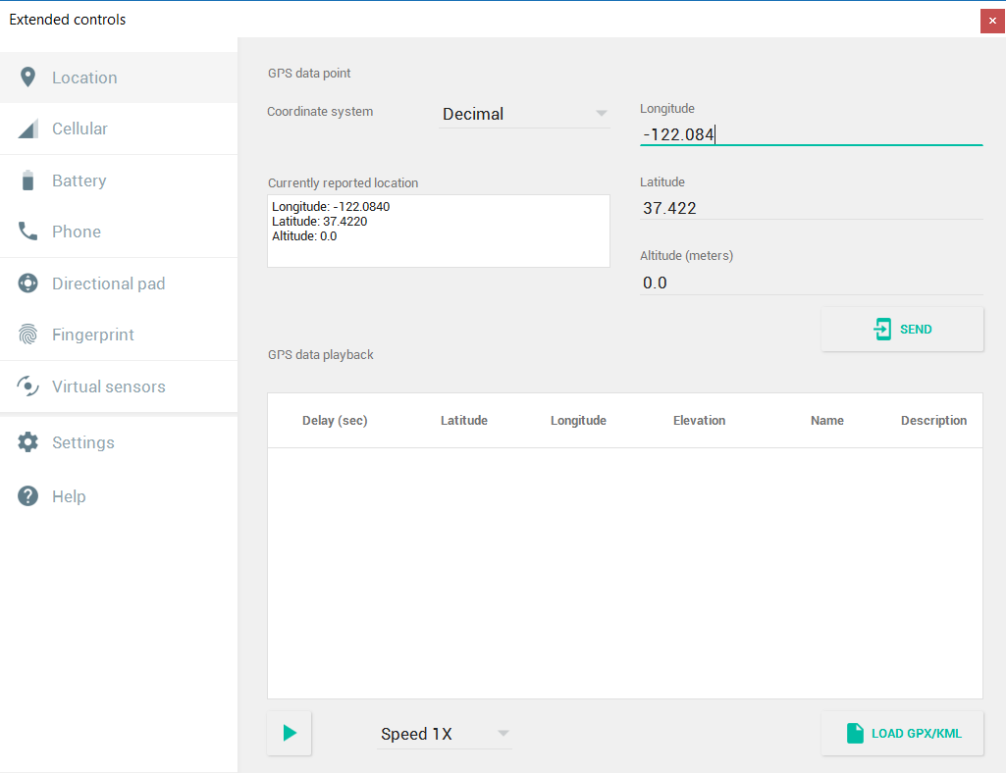
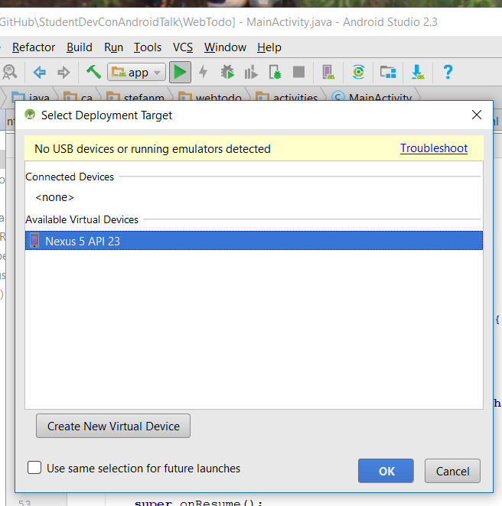
Android Studio: Running your app
Many options when running app:
Device (real/emulated)
Module / “Sub-app”
Debugging options
The emulator has simulation features.
Notes:
There are many options that can be set when running your app.
You can set:
- On which device the app runs on
- Which run configuration is run (app, in this case, though larger projects may have different modules)
- Whether or not to attach the debugger
-
Click the play button.
Stop kills the app
The debugger buttons.
Talk about the location simulation.

Slide 16
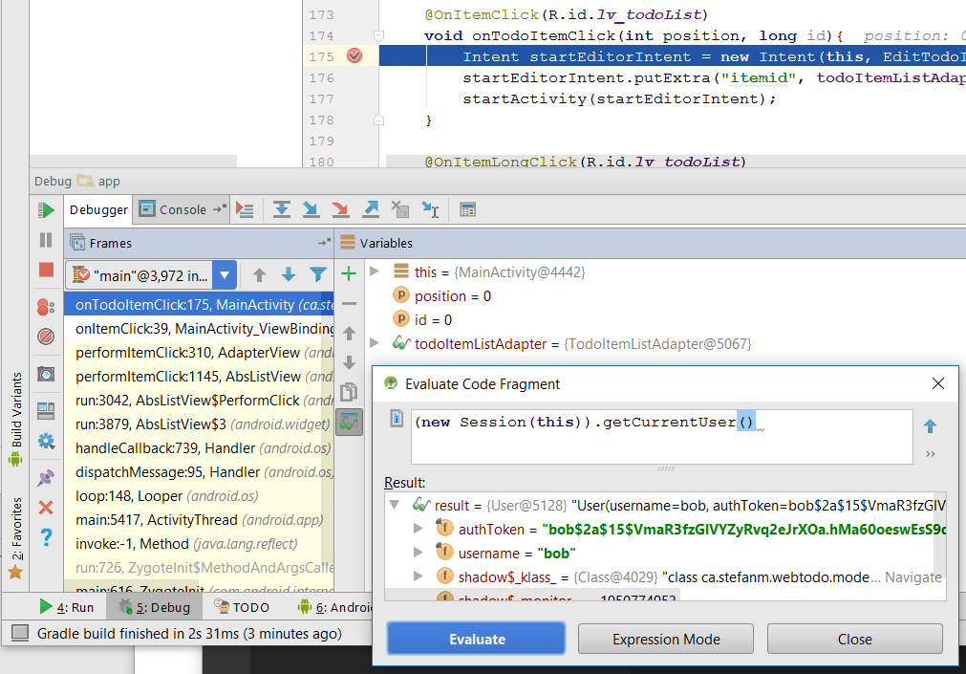
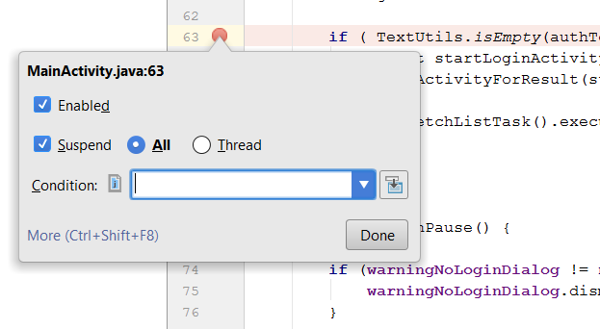
Android Studio: Debugging
Live debugging is much faster than print-statements
Debugging flow:
Set Breakpoints
Run app into breakpoint
Inspect data, run arbitrary code to verify assumptions
Make code/design changes
Notes:
We’ve all been there: print statement debugging. It’s quick to implement, but using the debugger will allow you to fix more bugs per “run”.
Many programming languages and environments let you debug your program as it’s running.
Android development, just like Java development, lets you step through your code as it’s running.
//Evaluate expression window.,

Slide 17
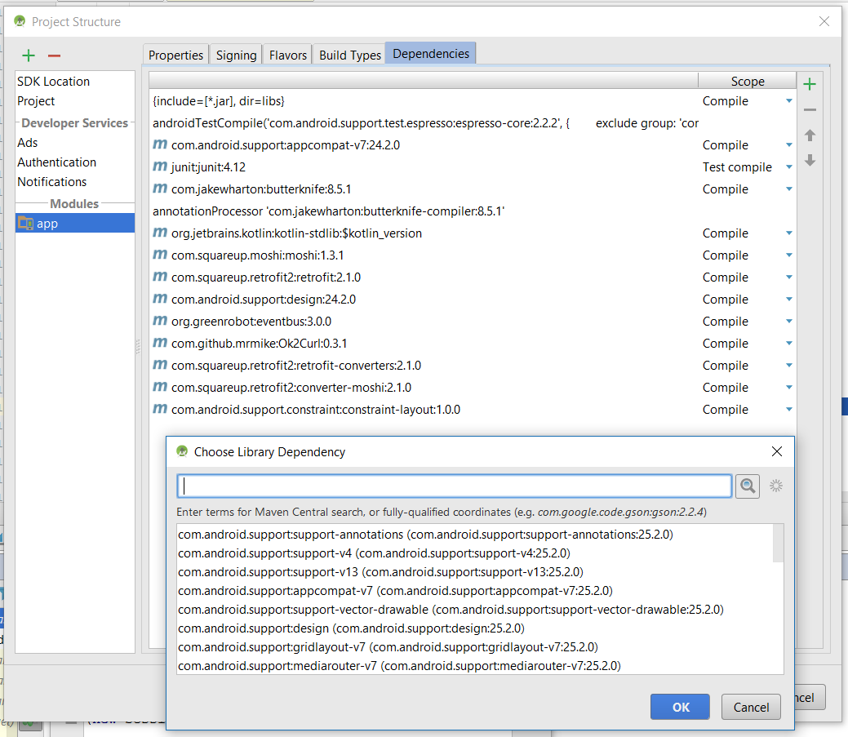
Android Studio Setup: Adding Libraries to your Project
Android uses the Gradle build-system.
Other systems exist too. Most notably: Buck, from Facebook.
Gradle lets you:
Add libraries to your project
Specify build variants & flavours
Perform compile-time build tasks
Gradle files are written in Groovy and can be quite complex.
To (simply) add libraries,
Right click on “app” (module)
Select “Open Module settings”
Notes:
Introduce what Gradle is, gradle scripts. Gradle sync,
Show how to add libs.
Don’t go into too much detail here. Just show this is possible, and many things are possible.
Build Variants,
Build Flavours

Slide 18
Building Blocks
Activities
1
Services
3
UI Components
2
Notes:
4 main app components:
Activities,
Services,
Content Providers,
Broadcast Receivers.

Slide 19
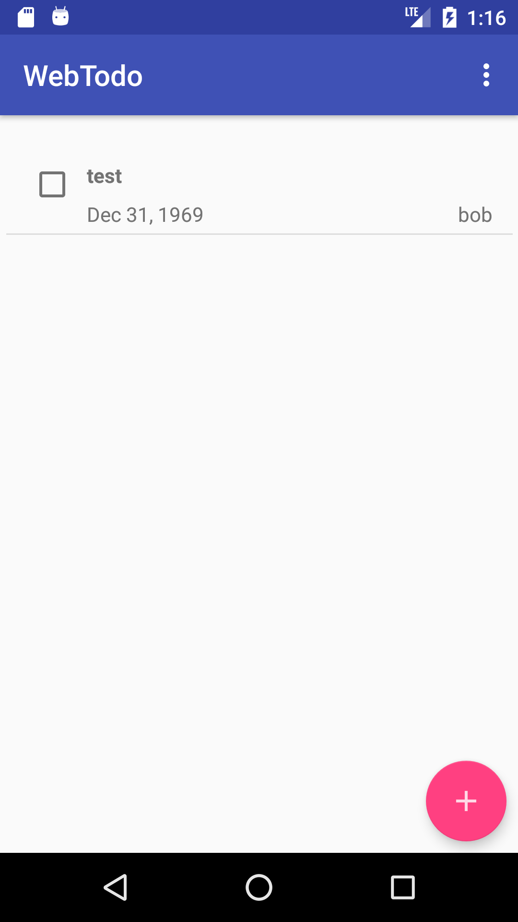
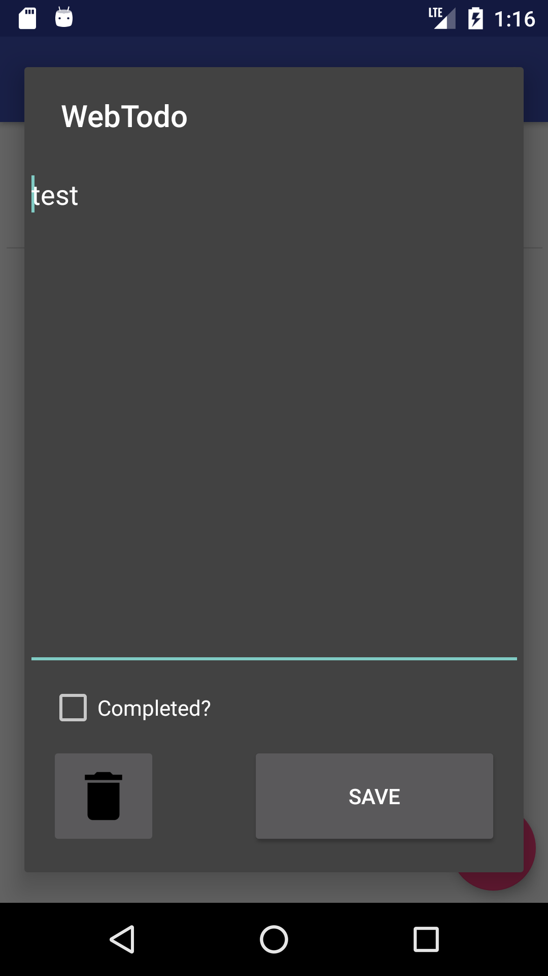
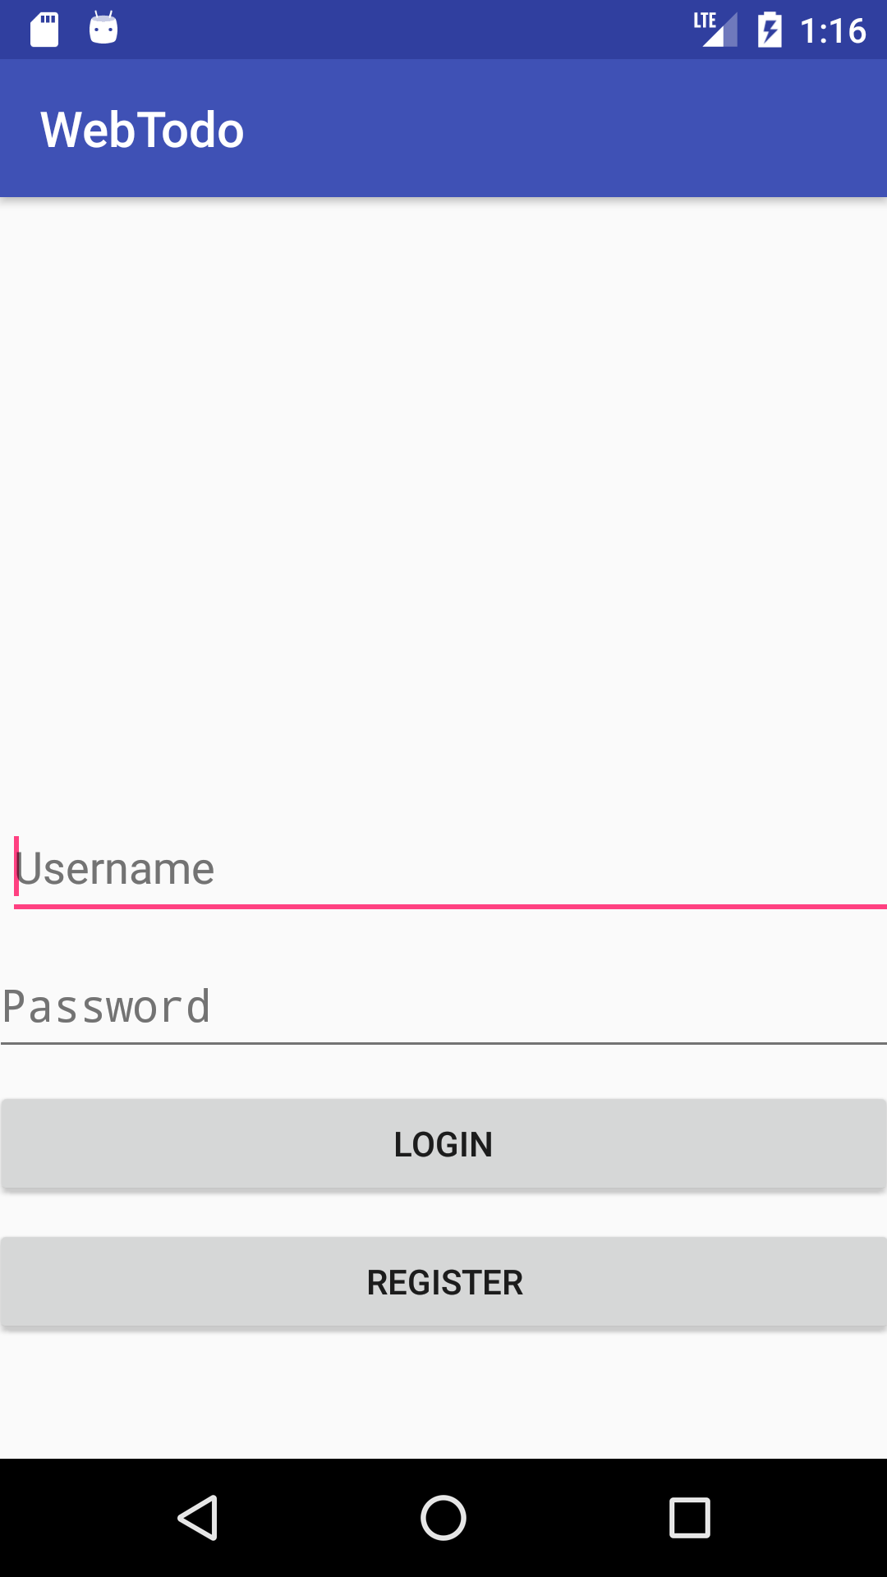
Activities: Introduction
An Activity is “a single, focused thing the user can do”
Corresponds roughly to one “page” of your application
When making an app, plan out activities first.
Main
Activity
(Todo List Viewer)
Todo Item Editor
Activity
Login
Activity
Notes:
Activities are the central concept of Android applications.
The idea is that an activity corresponds to a single thing that a user can do.
Consider, conceptually, that in our example todo list app, there is:
-a page for viewing the list
-a page for logging into the app
-a page for editing the todo item.
Each of these 3 pieces have been implemented as an activity.
Examples of activities in other apps include:
- A “Take photo” activity in a camera app
- The newsfeed activity in the Facebook app
- The settings activity in Google maps, separate from the map activity.

Slide 20
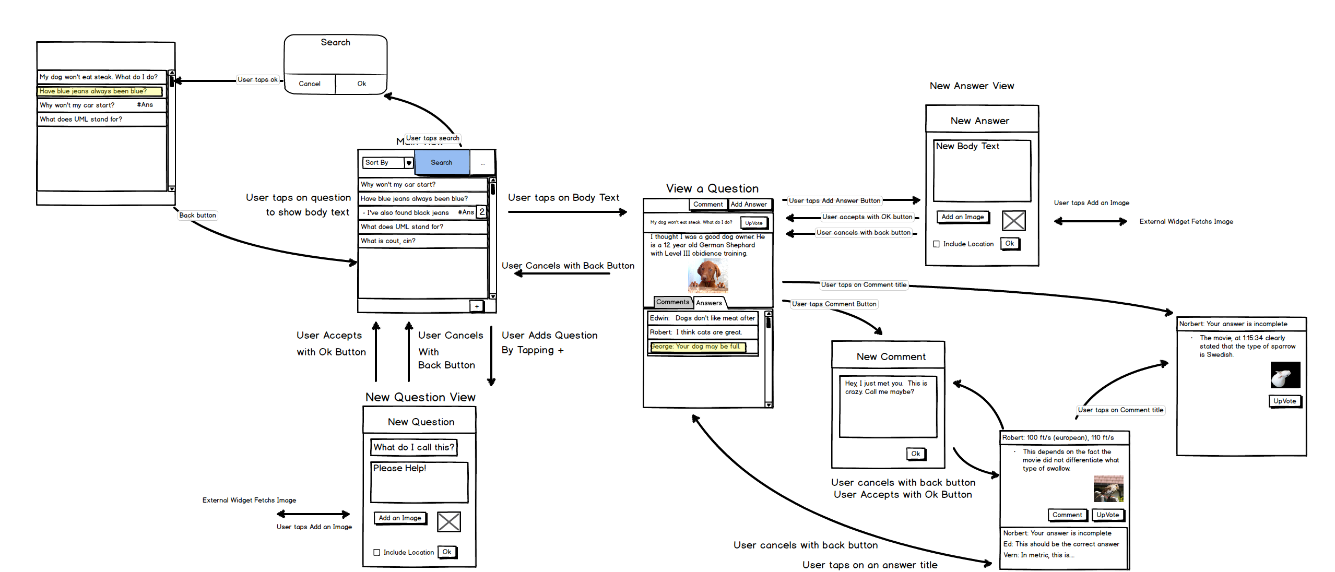
Android App Mockups
Notes:
When making an app, the best thing you can do to save development time is to make mockups.
It helps to sit down and plan out your app before you start writing code.
It helps answer questions you may have about:
- functionality and what the app should do,
- The structure of your code when making the app
- how to avoid scope creep.
It’s tempting to make an “everything app”, but one of the tricks to software development is to make the MVP, the Minimum Viable Product.
On this slide here, I’ve attached a mockup for an app I wrote in school for CMPUT 301. The overall requirements for this app were to build a
“Stack overflow clone”. There were 9 user stories given as requirements, and the design that was built was on the right.
It’s an art in software development to implement all of your requirements as simply as possible while still making the code expandable enough to facilitate future, unknown
Requirements.

Slide 21
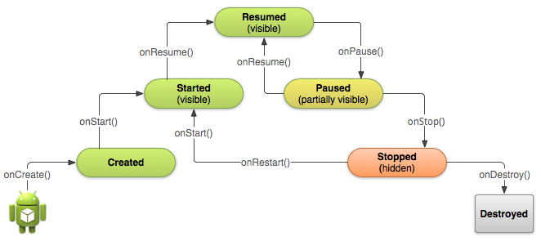
Activities: Lifecycle
Android uses a lifecycle concept to drive components.
Activities you write subclass the Android Activity class.
Activities have a lifecycle
onCreate()
One-time Initialization work
onResume(), onStart()
onPause(), onStop()
Uninitialization work
Others: onLowMemory(), etc.
Call finish() to end your activity
Notes:
Many constructs, including Activities, in Android have the notion of a lifecycle.
The idea behind a lifecycle is that your activity can respond to changing system events:
- If your activity is being created, it should do initialization work
- When your activity is being hidden, it can release resources, and stop doing work
- When your activity resumes by becoming visible again, it can resume that background work.
- Other call backs include onLowMemory and onBackPressed
This lifecycle is achieved through the use of Lifecycle methods. The Anrdoid system will call the lifecycle methods on your activity in the cases as shown on the right.
In the initialization-type functions, such as onCreate, you will typically want to initialize any user interface elements (discussed in the next section), bind to services that can do work, and so on.
One particular gotcha with the lifecycle is that calls to onDestroy are somewhat unpredictable: Android will typically not destroy your activity right after it has entered the stopped state.
If you want to end your particular activity, simply call finish().

Slide 22
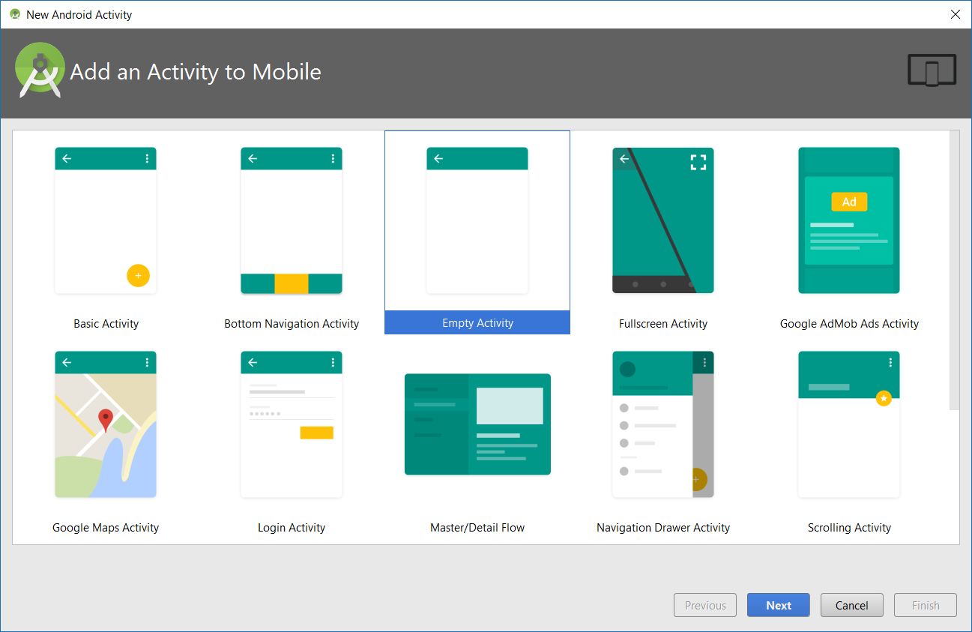
Activities: Construction & App Manifest
public class MainActivity extends AppCompatActivity { @Override protected void onCreate(Bundle savedInstanceState) { super.onCreate(savedInstanceState); setContentView(R.layout.activity_main); } @Override protected void onStart(){ super.onStart(); //Do work here } @Override protected void onResume(){ super.onResume(); //Do work here } @Override protected void onPause(){ //Do pausing here super.onPause(); } @Override protected void onStop(){ //Do cleanup here super.onStop(); } @Override protected void onDestroy(){ //Do cleanup here super.onDestroy(); } }
Constructing an Activity involves sub-classing the Android’s Activity class and adding it to the manifest.
Android studio makes it simple:
Right click on your app’s module,
New → Activity → Gallery
Notes:
Talk about how when you write activities, you are actually sub-classing Android’s activity class and adding it to the application manifest. Among other things, the The application manifest is a list of all of the activities in your app that can be started.
An example of a minimal activity implementing all of the lifecycle methods is shown at right.
Mention that the lifecycle methods require a call-super.

Slide 23
Activities: Construction & App Manifest
<manifest xmlns:android="http://schemas.android.com/apk/res/android" package="ca.stefanm.webtodo"> <uses-permission-sdk-23 android:name="android.permission.INTERNET" /> <uses-permission-sdk-23 android:name="android.permission.ACCESS_NETWORK_STATE" /> <uses-permission-sdk-23 android:name="android.permission.WRITE_EXTERNAL_STORAGE"/> <application android:allowBackup="true" android:icon="@mipmap/ic_launcher" android:label="@string/app_name" android:supportsRtl="true" android:theme="@style/AppTheme"> <activity android:name=".activities.MainActivity"> <intent-filter> <action android:name="android.intent.action.MAIN" /> <category android:name="android.intent.category.LAUNCHER" /> </intent-filter> </activity> <service android:name=".ListToGalleryIntentService" android:exported="false" /> <activity android:name=".activities.LoginActivity" /> <activity android:name=".activities.EditTodoItemPopupActivity" android:theme="@style/Theme.AppCompat.Dialog" /> </application> </manifest>
The Application Manifest is an XML file containing:
List of activities in your app
Which activities are launcher activities
Permissions required by your app
Services in your app, and services made available to other apps
Android Studio mostly takes care of the manifest when adding components, usually only minor edits are needed.
Notes:
The application manifest is a list of all of the activities in your app that can be called. Calling activities is done through the use of Intents, which we’ll discuss next.
The Manifest is where you declare which activity is the *Launcher Activity*, the activity that is called when the user clicks your application icon in the launcher. Interestingly, an application can have multiple launcher activities. A hypothetical social media app can have a launcher activity for a news feed, and another launcher activity for a chat activity, all within the same “app”.
The manifest is also where you declare the permissions that your app requires. Permissions are an important part of Android development, although you can get started without worrying about them. However, if you want to publish your app to the play store, then you must properly implement asking users for permissions.

Slide 24
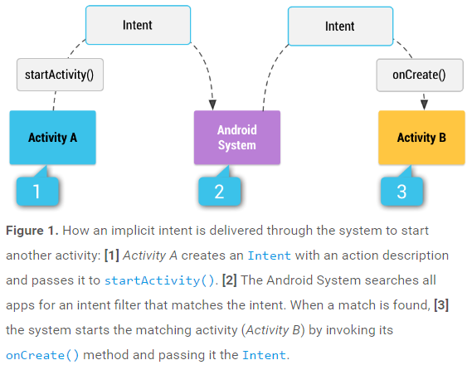
Intents
“A messaging object you can use to request an action from another app component”
Versatile
Can ask android to execute parts of your own app, as well as other apps
Most visibly, the “Send To” button
Need to use intents to start other activities in your app.
Intent startEditorIntent = new Intent(this, EditTodoItemPopupActivity.class); startEditorIntent.putExtra("itemid", 3); startActivity(startEditorIntent);
Image source: https://developer.android.com/guide/components/intents-filters.html
Notes:
Earlier we briefly mentioned “services your app makes available to other apps”. This seems out of place, with it being in the middle of our expose on activities.
However, Android also has another interesting design decision: Intents.
Officially, an Intent is “a messaging object you can use to request an action from another app component.”
Intents can have extras, flags, and actions.
Typically, when writing android applications, you rarely call other code to execute. Instead, you usually end up writing code that is executed by the system, and then asking the system to execute your code.
Intents are versatile in they you can not only ask android to execute parts of your own code, you can also ask Android to execute parts of other people’s apps. The most visible application of this is the “Send to” button on Android.
Let’s say that our todo list app has a menu item to send a picture of our todo list to someone. When we select that menu item a chooser window pops up, asking us whether we’d like to share the list by email, send to google plus, send to OneNote, and so on.
How this works under the hood, is that when you select the share item, a broadcast intent with the ACTION_SEND action is sent to the android system. Then, the android system looks at all of the apps on the device and reads their manifest files. If the other apps’ manifest contains an intent filter that matches the intent being sent out by your app, then Android is able to present that app to you in a chooser. If you pick that app in the chooser, android sends the intent to that application, and then the app can process your request.
There are implicit intents, and explicit intent.
- An explicit intent names the component you want. “I want Activity B from com.stefanm.webtodo”
-An implicit intent is more tightly bound to an action you want to perform. It’s like saying “I want someone to take a picture, and I want the photo taken.”

Slide 25
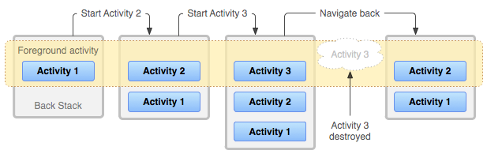
Activities: Navigation
By default, Activity navigation forwards and backwards happens on a “back stack”
Last In, First Out (LIFO) stack.
Think of each activity as a playing card.
There are ways to add hierarchy to the back stack using “Task affinities”, though it’s beyond the scope of this talk.
More information: https://developer.android.com/guide/components/activities/tasks-and-back-stack.html#ManagingTasks
Notes:
Briefly mention back stack
Override onBackPressed if needed
Consider overriding onResume to go to a login activity… something like that.
Navigation in Android is one of its sore spots compared to iOS.

Slide 26
Activities: Callback Methods
Main Activity
Android
Activity B
Intent startLoginActivity = new Intent(this, LoginActivity.class); startActivityForResult(startLoginActivity, LOGIN_REQ);
setResult(RESULT_LOGGEDIN);
@Override public void onActivityResult(int requestCode, int resultCode, Intent data){ if (requestCode == LOGIN_REQ){ switch (resultCode){ case LoginActivity.RESULT_LOGGEDIN: case LoginActivity.RESULT_REGISTRATION_OK: new FetchListTask().execute(); default: showLoginWarningDialog(); } } }
finish();
You can start Activities for a result.
Once the other activity finishes with a result, Android calls your activity’s onActivityResult() method.
A similar approach is used for Android 6+ permissions requests.
Notes:
Android also allows you to start another activity for a result.
The idea is that your activity needs to ask the user a “question”, such as getting a photo, requesting the user to select a profile, etc.
Your activity can start the “asking activity” for a result. That other activity launches, typically with an extra in the intent saying that is must return a result.
That second activity eventually calls
setResult()
Finish()
And then control is returned to your activity.
Start activity for result, onactivity result
Startactivity for result.
Other activity calls SetResult() then finishes
Then we jump back to where we were in onActivityResult.

Slide 27
UI Components

Slide 28
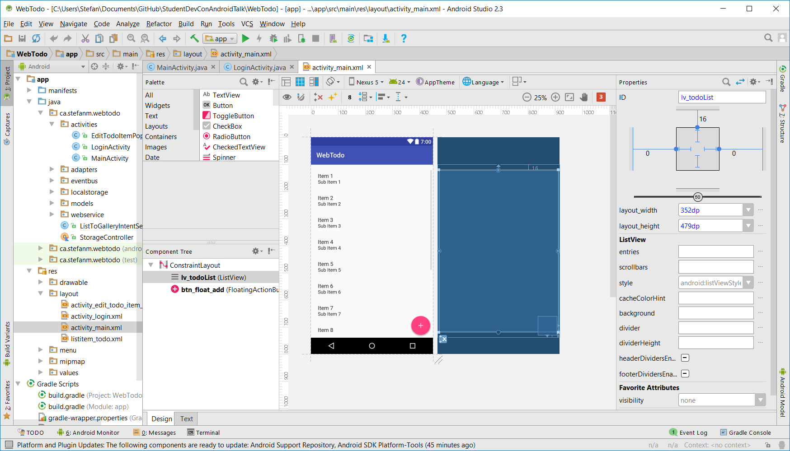
UI Components: Layout
User interface layouts are designed declaratively in Android Studio using XML.
Android Studio provides graphical layout editing.
Every element is given an id (R.id.*) and can be attached to event listeners.
Layouts are transformed from XML files into a tree of View and ViewGroup objects during the build process.
Notes:
Segue into next section.
Breifly mention that Fragments exist, have their own life cycle, and are like “Sub activities”.
Layout XML. Defined at dev time, populated/inflated at run time.
Screenshots of UI builder.
Emphasize keeping good ui names.
Talk about R
Talk about Butterknife.
Talk about the events. OnItemClick, onClick, onLongClick.
Mention list views.
List Item views.
List adapters.

Slide 29
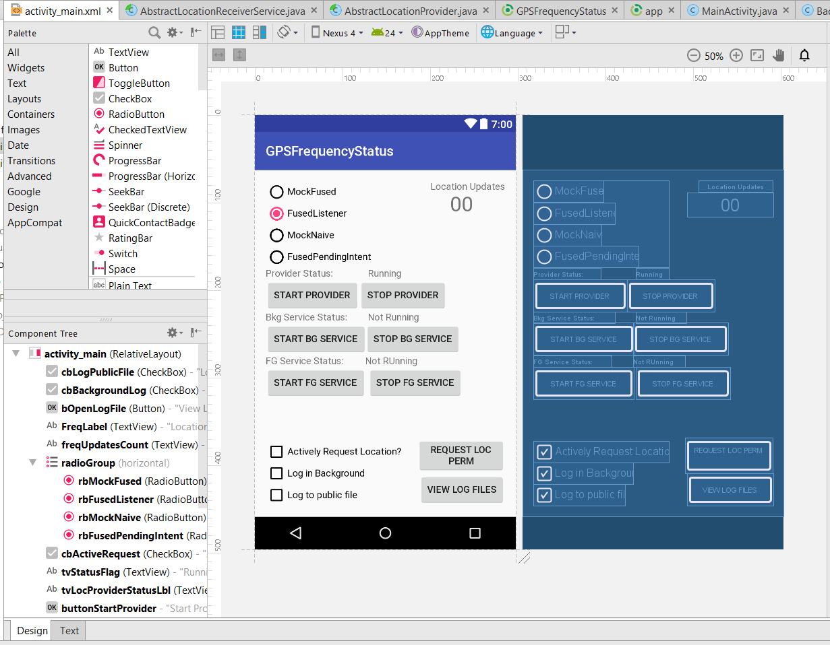
UI Components: Widgets
Android provides the usual gamut of widgets.
Buttons, Checkboxes, etc.
ListView and GridView
Challenges:
Different layouts for tablets vs. phones
Internationalization
Notes:
Android provides a wide variety of widgets that can be used in an application.
It has the usual buttons, spinners, checkboxes, and so on.
It also has a several fancier widgets, like the ListView and GridView. These widgets are notable since each item in a list view or grid view can have it’s own separate layout.
There is also a RecyclerView, which we won’t get into today. Mention it’s the Facebook news feed
As well, Android has Fragments, which are, conceptually, “Sub-activities”.

Slide 30
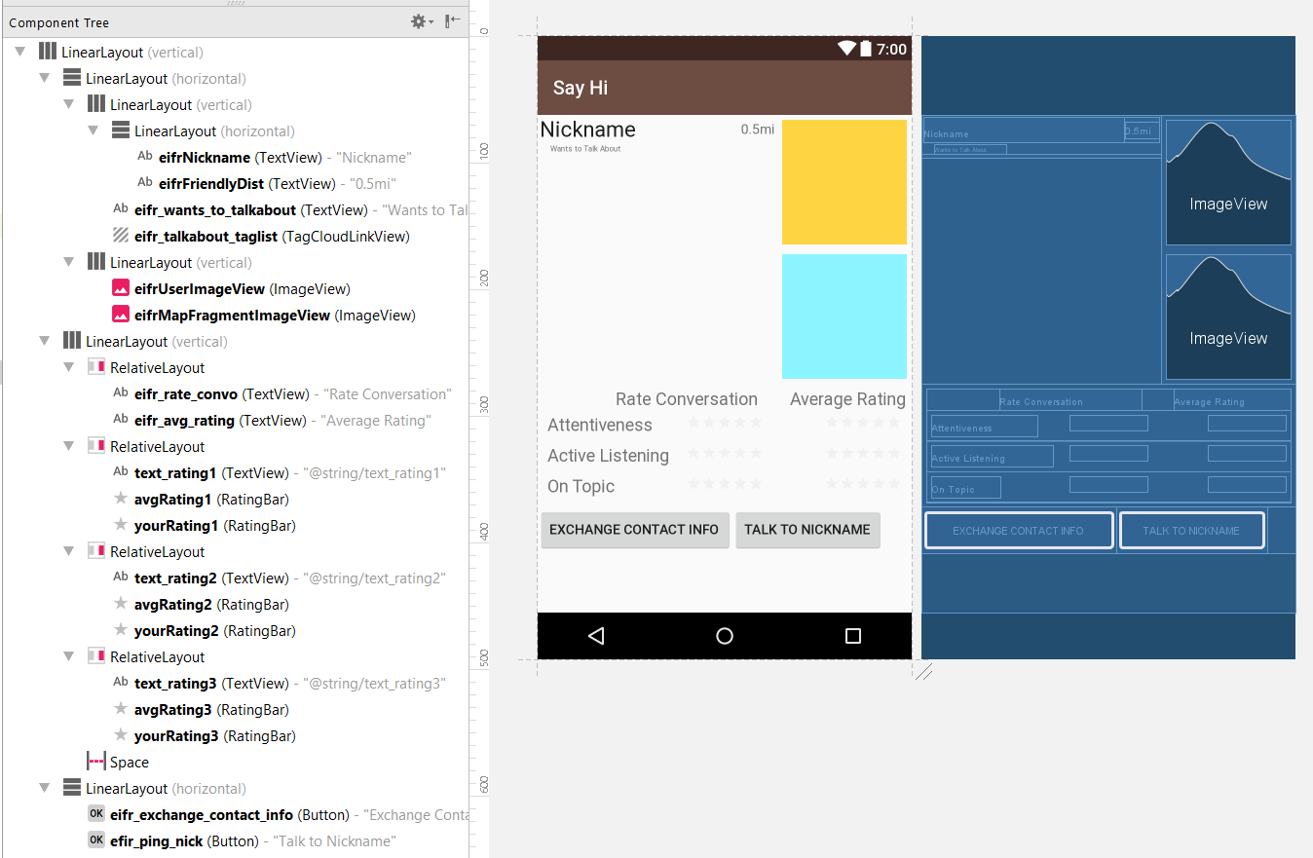
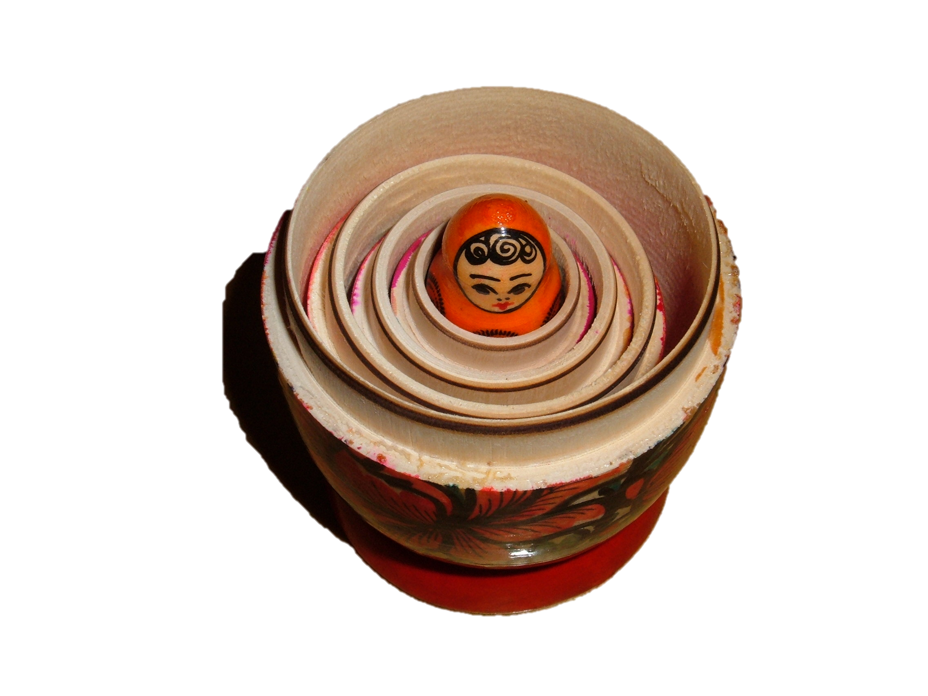
UI Components: Layout
Complex Layout using Nested Linear Layouts:
Basic layout techniques:
Linear Layout
Relative Layout
The traditional way to make layouts is to nest the basic layout techniques
Modern layouts use Constraint Layout
Image: By BrokenSphere - CC BY-SA 3.0, https://commons.wikimedia.org/w/index.php?curid=3773186
Notes:
It’s important to have your layout scale to multiple screen sizes and aspect ratios.
For this reason, we need a way to make layouts expand proportionally to have their components fill the space allotted.
The traditional way to do this was to nest Linear and Relative layouts in each other.
Recently, however, Android added Constraint Layouts as a straightforward way to arrange UI Elements.

Slide 31
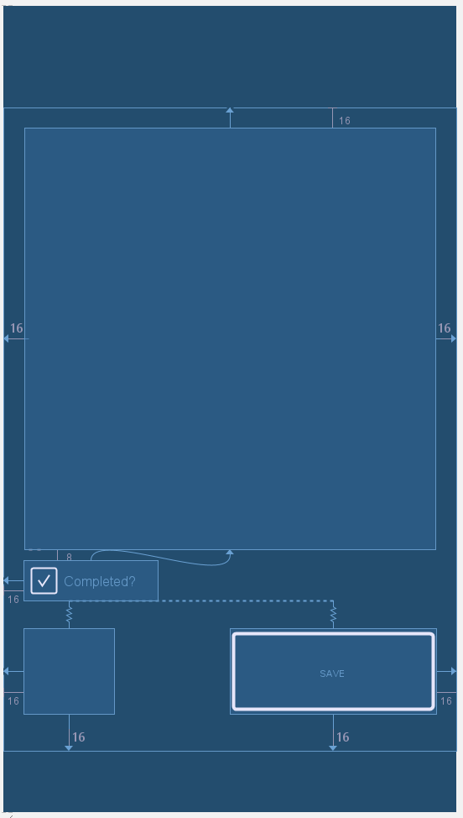
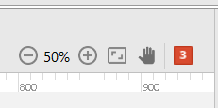
UI Components: Constraint Layout Example
Constraint Layouts make it easy to plop widgets onto a screen.
Be sure to pay attention to the linter errors and warnings to ensure the layout works at run time.

Slide 32

UI Components: Events
Widgets have input events:
OnClick
OnLongClick
OnFocusChange
onKey
onTouch
onItemClick
…
Event Listeners need to be bound / registered to widgets.
Image Source: https://s-media-cache-ak0.pinimg.com/736x/89/9b/83/899b8365ef3af7177531855353f629bd.jpg
Notes:
Ask who’s done any Visual Basic programming?

Slide 33
UI Components: Binding to, Ye Olde way
View binding typically done in onCreate lifecycle method.
Input Event listeners also bound at this time too.
findViewById()
Slow at run-time
Error-prone: ClassCastExceptions
TextView nickname = (TextView)findViewById(R.id.eifrNickname); TextView friendlydistance = (TextView)findViewById(R.id.eifrFriendlyDist); TagCloudLinkView talktopics = (TagCloudLinkView)findViewById(R.id.eifr_talkabout_taglist); ImageView userImage = (ImageView)findViewById(R.id.eifrUserImageView); ImageView mapImage = (ImageView)findViewById(R.id.eifrMapFragmentImageView);
questionView.setOnItemClickListener(new AdapterView.OnItemClickListener() { @Override public void onItemClick(AdapterView<?> parent, View view, int position, long id) { // run off to the question view if you tap an item final Question question = qla.getItem(position); UUID qId = question.getId(); Intent intent = new Intent(getApplicationContext(), QuestionActivity.class); intent.putExtra("QUESTION_UUID", qId.toString()); startActivity(intent); } });
Notes:
Remember how I mentioned there was setup work in the onCreate?
Well, the classical way
Pull example code from Qasper.
Briefly mention that we’re going to get much more example driven for this part.

Slide 34

UI Components: Binding to, using Butterknife
Commonly used library to bind views to instance variables.
Lets you easily bind listeners to views.
@Override protected void onCreate(Bundle savedInstanceState) { super.onCreate(savedInstanceState); setContentView(R.layout.activity_main); ButterKnife.bind(this); }
@BindView(R.id.lv_todoList) ListView todoListView; TodoItemListAdapter todoItemListAdapter;
@OnItemClick(R.id.lv_todoList) void onTodoItemClick(int position, long id){ Intent startEditorIntent = new Intent(this, EditTodoItemPopupActivity.class); startEditorIntent.putExtra("itemid", todoItemListAdapter.getItem(position).getId()); startActivity(startEditorIntent); }
Image source: https://github.com/JakeWharton/butterknife

Slide 35
List Views, List Items, Adapters
List Views and Grid Views show data
Each item in the view needs to have a layout
Adapters translate the data item to be drawn into a view
When populating the data store that backs a list/grid view, remember to call notifyDatasetChanged().
@Override public View getView(int position, View convertView, ViewGroup parent){ //Get the data to final TodoItem todoItem = getItem(position); //Little bit of magic to get a layout that we can populate. if (convertView == null){ //Layout inflaters take the XML layout data and make
Java Objects that we can manipulate. convertView = LayoutInflater
.from(getContext())
.inflate(R.layout.listitem_todo, parent, false); }
//Populate views here return convertView; }
Notes:
Mention how in the adapter we use a layout inflater to manually inflate the xml into a layout.
//TODO show the adapter code here.,
An adapter is the layer between a backing data store, such as an Array or Content Provider.
An adapter is registered to a list view or grid. When Android needs to paint a set of data into a list or grid view, it asks the adapter registered to it to take the item, and return a populated view. Android then injects the views into the List View or Grid View.
It’s important to mention here that recycler views exist. Recycler views are more resource efficient: the parts of the Recycler View that have sub views injected into them are recycled once the sub view is no longer visible.

Slide 36
AsyncTasks & Threading

Slide 37
Threading & AsyncTasks
private class DeleteItemTask extends AsyncTask<Void, Void, StorageController.StorageControllerResult<Unit>>{ ProgressDialog loadingDialog = null; @Override protected void onPreExecute() { loadingDialog = ProgressDialog.show(mContext, "Loading", "Fetching TODO Item..."); } @Override protected StorageController.StorageControllerResult<Unit> doInBackground(Void... params){ StorageController.StorageControllerResult<Unit> fetchResult = StorageController.INSTANCE.deleteTodoItem(mContext, currentlyEditedTodoItem); return fetchResult; } @Override protected void onPostExecute(StorageController.StorageControllerResult<Unit> fetchResult) { loadingDialog.dismiss(); if (!fetchResult.getSuccess() && fetchResult.getData() != null){ new AlertDialog.Builder(mContext) .setMessage("Deleting item failed.") .setPositiveButton("Ok", new DialogInterface.OnClickListener() { @Override public void onClick(DialogInterface dialog, int which) { finish(); } }) .create() .show(); } finish(); } }
UI thread responsible for drawing and input method handling
Don’t block the UI thread.
Network on main thread causes exception.
Threads work well, but can be hard to manage.
AsyncTasks
Notes:
Threads = bad
AsyncTask = good
Briefly mention thread executors.
Event Bus works too.

Slide 38
Services

Slide 39
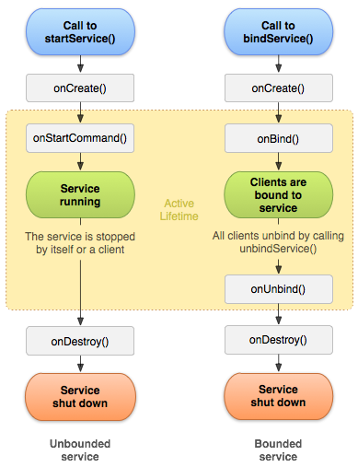
Service Lifecycle
Services have a much simpler lifecycle than activities
Two ways to start:
startService()
bindService()
Services do background work.
Bound services let you bind your component to the service and call methods on it.
Intent Services are convenient
Notes:
Services in UI Thread. Make sure to use threads.
Examples:
Fetching services
Location Processing Services
Authentication/Authorization Services.
Multi Process

Slide 40

What do apps do?
Interact with the user
Forms, Data Entry
Processing Output
Persist Data
Shared Preferences
Local SQLite DB
Communicate to a web service
Authentication/Login
JSON/REST
gRPC
Integrate with other apps
Notes:
Games?

Slide 41

Kotlin Interlude
About half of the code in the example app is written in Kotlin
Kotlin is a new language from JetBrains
Compile to JVM and Javascript
Null-safe
Lambdas
Bells and whistles
Easy to read and learn.
https://kotlinlang.org/
Notes:
Kotlin Interlude later?
Audience: People who’ve done some java. Don’t make this too long, since we’ll lose all the beginners and high school students.
Just mention some perks, and some bells and whistles.
What is it?
Why Kotlin over java?
Is it hard to learn?
Is it hard to use?

Slide 42
Demo

Slide 43
Thank You
Code & Presentation on GitHub:
https://github.com/linster

